Slide 1
Design of a 4-bit Simple As Possible (SAP) Computer
Course No: EEE 458
Course Name: VLSI Circuits and Design II Laboratory
Course Instructor:
Dr. A.B.M. Harun-Ur-Rashid Rifat Shahriar
Professor, Department of EEE, BUET Lecturer, Department of EEE, BUET
Prepared By:
Ramit Dutta Shafin Bin Hamid
ID: 1606006 ID: 1606008

Slide 2
Outline
Discussion of design criteria and basic building blocks
Demonstration of functional verification using EDA Playground
Simulation using Cadence NC-Sim and Sim Vision
RTL logic synthesis using Cadence Genus
Physical design using Cadence Innovus
Investigation of Design Rules Check (DRC) errors

Slide 3
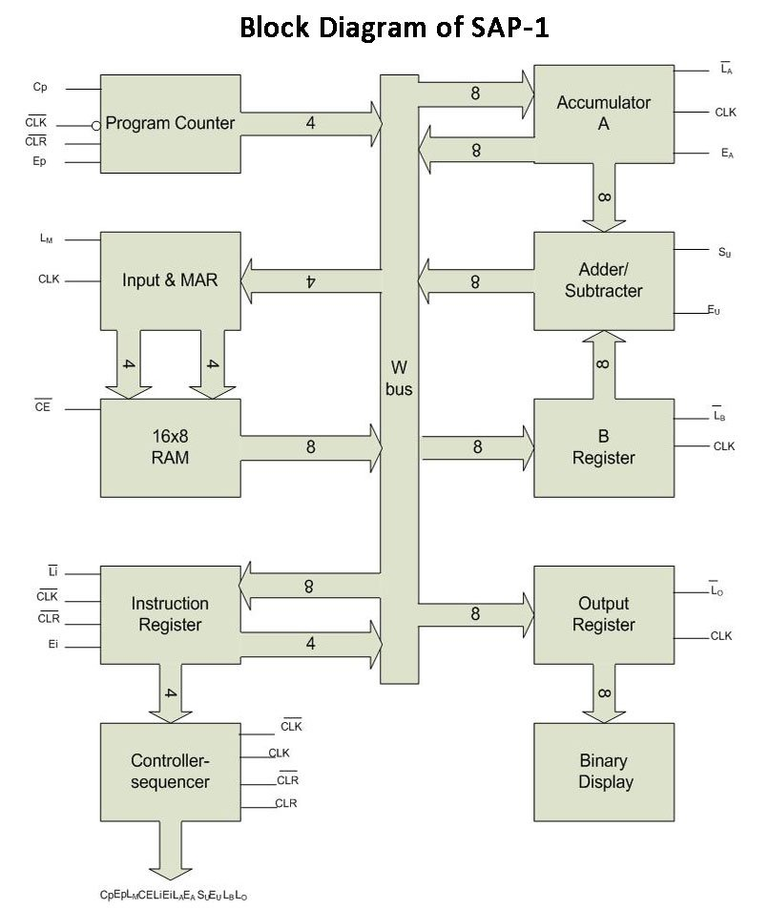
Design Route
Program Counter Testbench
Testbench
RAM Testbench
MAR Testbench

Slide 4
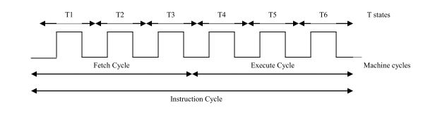
Design Route
Need to make all the modules work synchronously
So everything happens as and when they are required to do so
Build a Control Sequencer to generate control signals for synchronization
Control Sequencer is the brain of the computer because it controls which modules are active/inactive
The operation based on the control signal happens on the next posedge
Control signals are generated at the negedge

Slide 5
Final Design
RAM Size is 16 * 8
First 9 locations contain instructions
Next 7 locations are for storing data
Instruction length is 8 bits
Data length is 4 bits
For data, first 4 bits are set to zero
First 4 bits of instruction are opcode, second 4 bits are operand
For instructions that do not have a valid operand, last 4 bits are set to zero
All ALU operations are done with 4-bit registers

Slide 6
Instruction Set
Instruction | Operation | Opcode
LDA Address | Load the accumulator with the content located at the specified address of RAM | 0000
ADD Address | Add to the accumulator the content located at the specified address of RAM | 0001
SUB Address | Subtract from the accumulator the content located at the specified address of RAM | 0010
OUT | Display the content of the output register | 1110
HLT | Halt program execution (stops the program counter from incrementing) | 1111

Slide 7
Demonstration of the Computer
RAM Index | RAM Content at Index
0 | 0000_1001
1 | 0001_1010
2 | 1110_0000
3 | 0010_1011
4 | 1110_0000
5 | 1111_0000
6 | 0001_1010
7 | 1110_0000
Assembly Code
Conversion to machine code and mapping
LDA 9h ;move RAM[9] to A
ADD Ah ;add RAM[10] to A
OUT ;display A
SUB Ah ;subtract RAM[11] from A
OUT ;display A
HLT ;halt program execution
ADD Ah ;add RAM[10] to A
Data Segment
OUT ;display A
RAM Index | RAM Content at Index
9 | 0000_1011
10 | 0000_0001
11 | 0000_0011

Slide 8
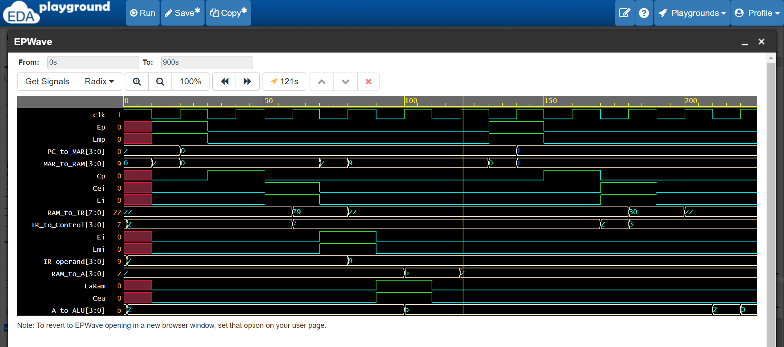
Demonstration of the Computer
LDA 9h
Control signal generation occurs at negedge clock
Generation of control signals resemble ring counter
Data transfer occurs at next posedge clock
A=11 at the end of first instruction cycle

Slide 9
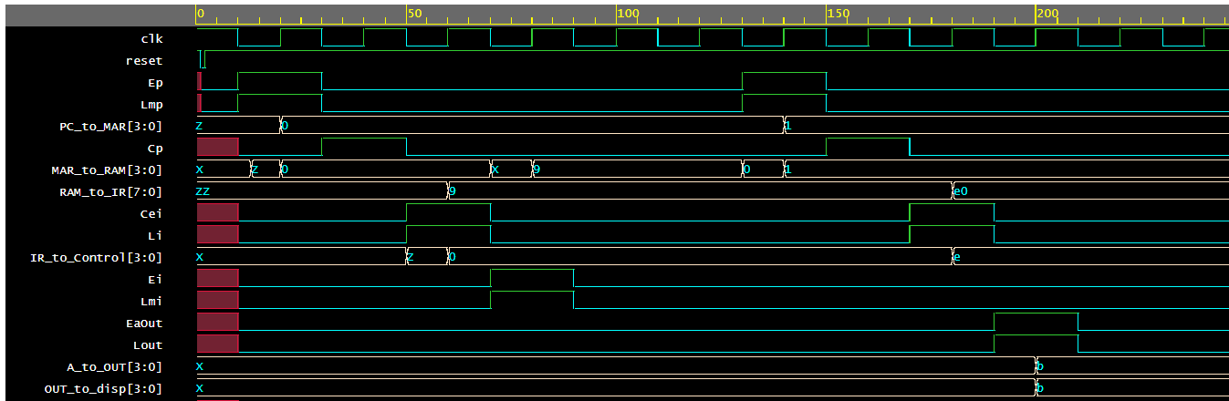
Demonstration of the Computer
OUT
First three T states are similar
A sends data to output register

Slide 10
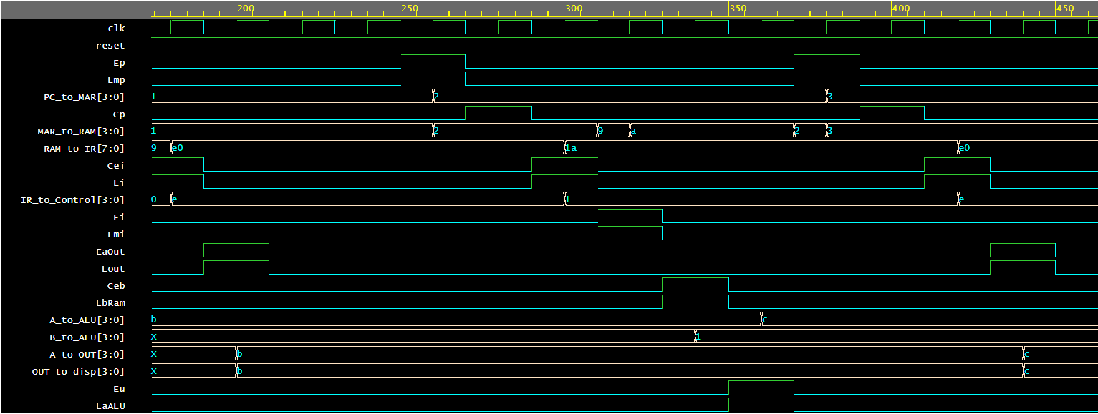
Demonstration of the Computer
ADD Ah
OUT
RAM[10] goes to B
ALU Computes A+B
A=Ch

Slide 11
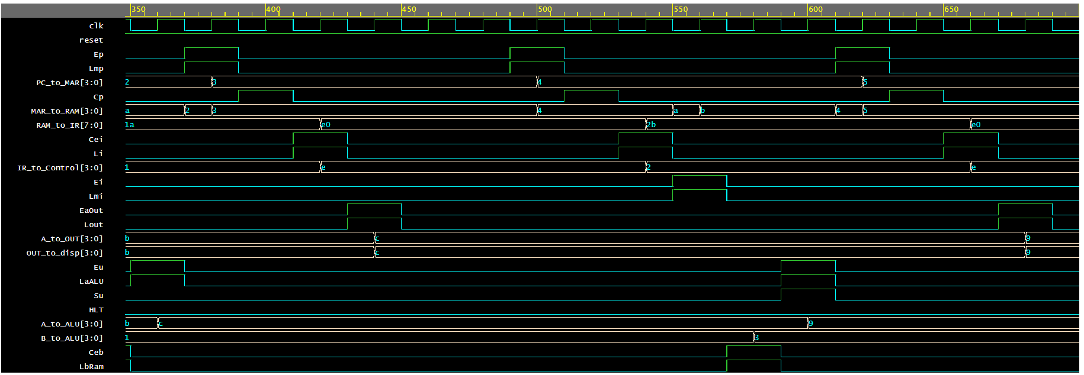
Demonstration of the Computer
SUB Bh
OUT
ALU Computes A-B
RAM[11] goes to B
A=9h

Slide 12
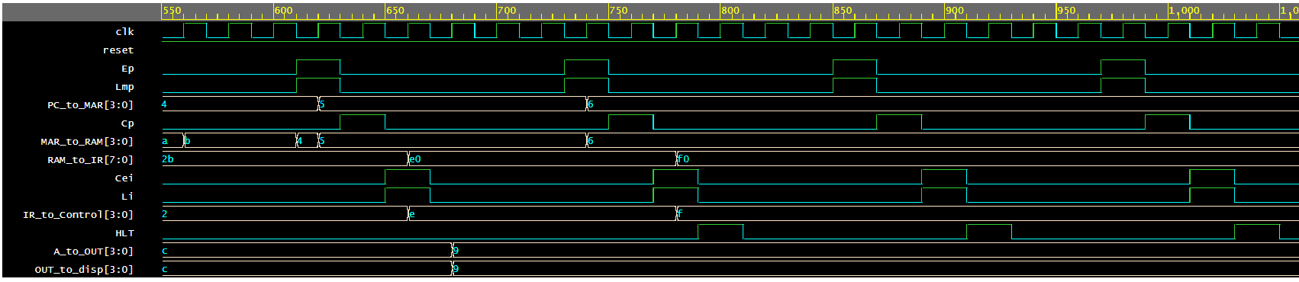
Demonstration of the Computer
HLT
PC keeps fetching the same instruction
Program counter value is indefinitely set to 6.

Slide 13
Challenges of multiple modules
Due to the usage of multiple modules, our design could not be synthesized all at once
We can synthesize each module separately, but if we try to synthesize using multiple modules, then the netlist file remains blank
To solve this situation, we converted the code into a single module
The inputs are clock, reset, input mode, input addresses and input instructions
The output is a 4 bit data output that is to be displayed from the output register
From here on, all results will be discussed based on aforementioned inputs and outputs

Slide 14
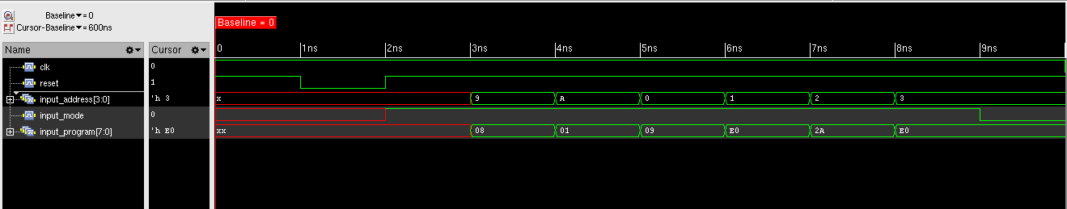
Simulation using Cadence NC-Sim and Sim Vision – Inputs

Slide 15
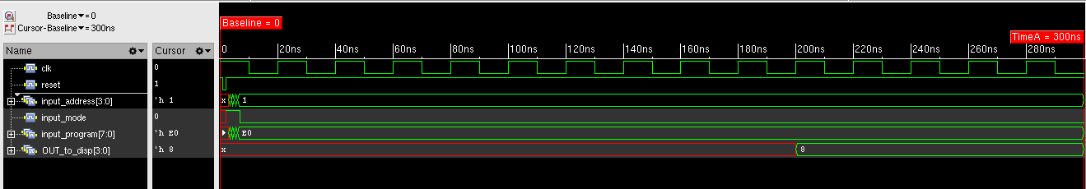
Simulation using Cadence NC-Sim and Sim Vision – LDA+OUT Testbench

Slide 16
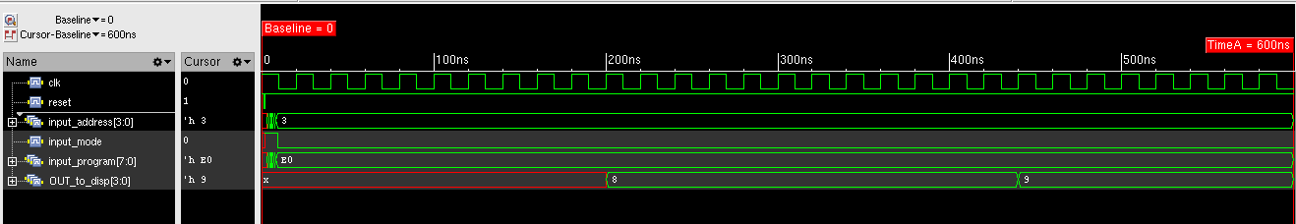
Simulation using Cadence NC-Sim and Sim Vision – ADD+OUT Testbench

Slide 17
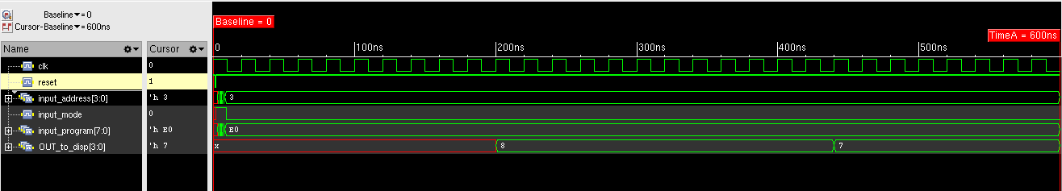
Simulation using Cadence NC-Sim and Sim Vision – SUB+OUT Testbench

Slide 18
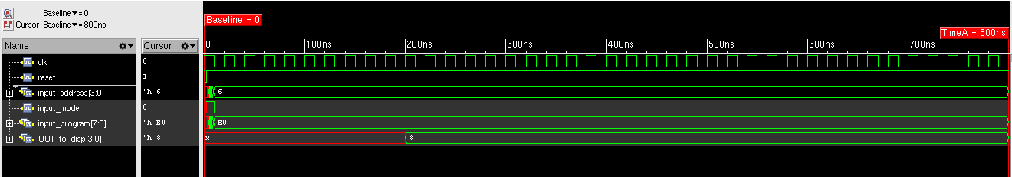
Simulation using Cadence NC-Sim and Sim Vision – HALT Testbench

Slide 19
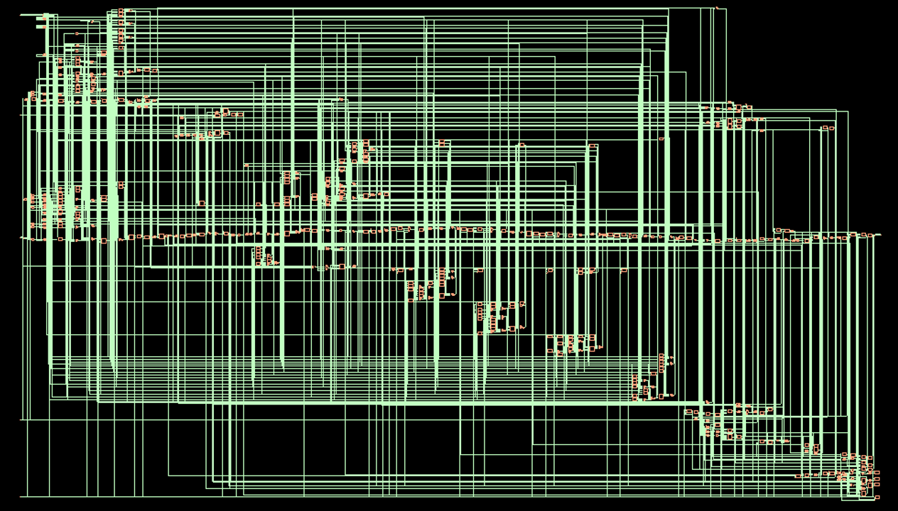
Schematic

Slide 20
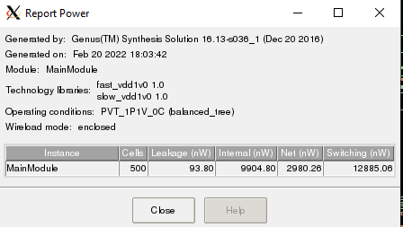
Power Report

Slide 21
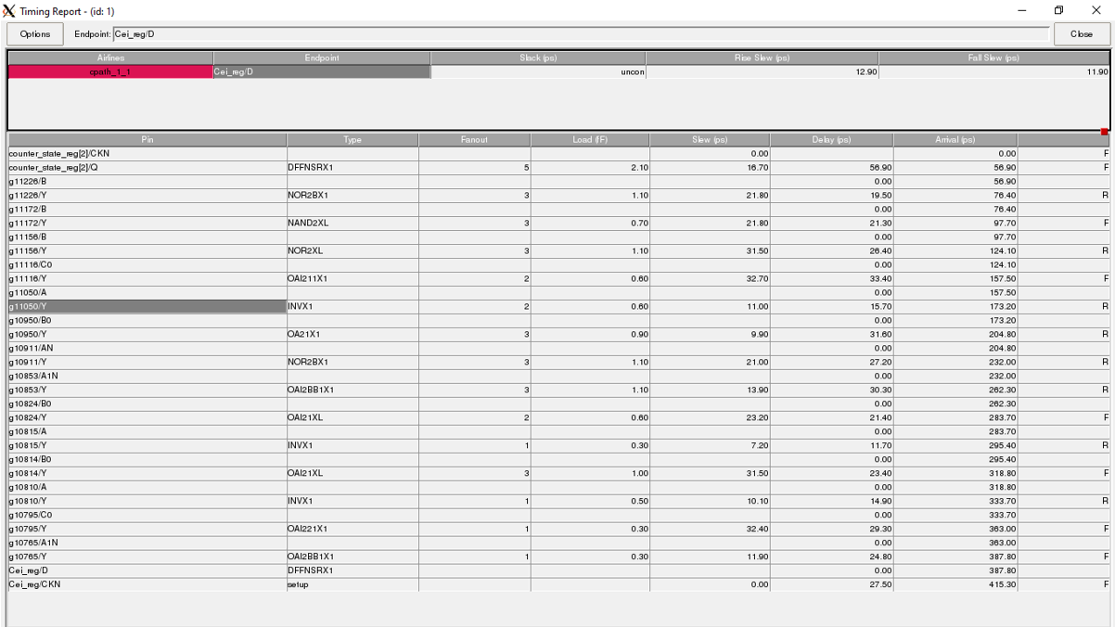
Timing Report

Slide 22
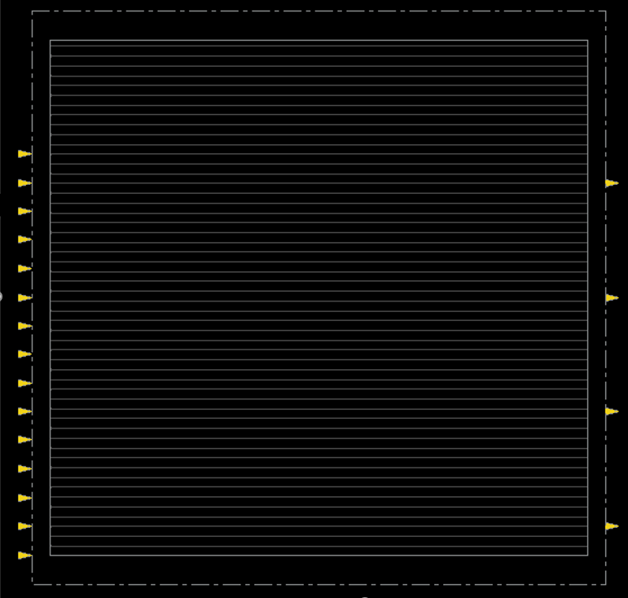
Physical Design - Floorplan
Floorplan parameters:
Die size is 100 by 100
Total number of input pins = 15
Total number of output pins = 4
Input pins spacing = 5
Output pins spacing = 20
Pinwidth = 0.14
Pindepth = 0.28
Core to left/right = 3
Core to top/bottom = 5

Slide 23
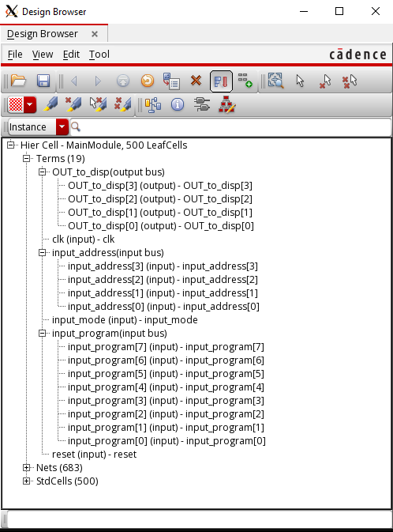
Physical Design – Design Browser

Slide 24
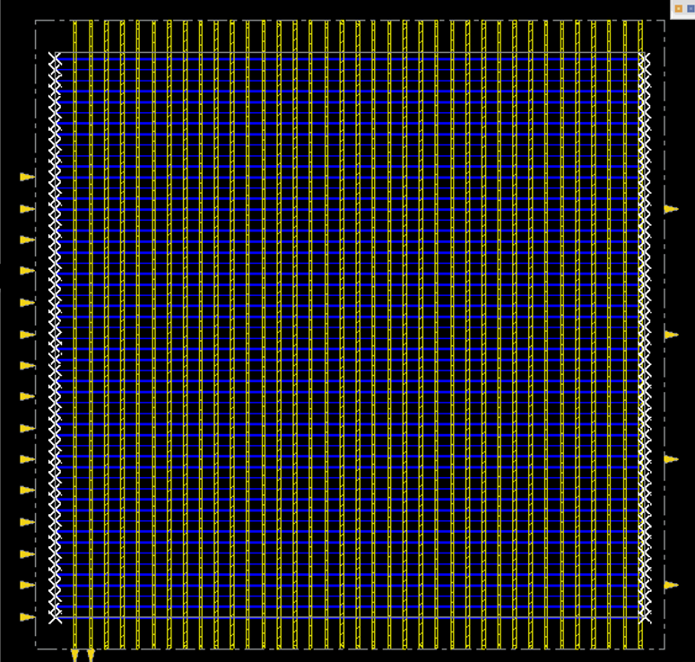
Physical Design – Adding power stripe & routing
Power Stripe:
Metal4 layer is used
Width of each strip = 0.5
Spacing between VDD and VSS = 2
Set to set distance = 5
First strip starts a distance 3 away from left core boundary
Route:
For top layer, Metal4 layer is used
For bottom layer, Metal1 is used

Slide 25
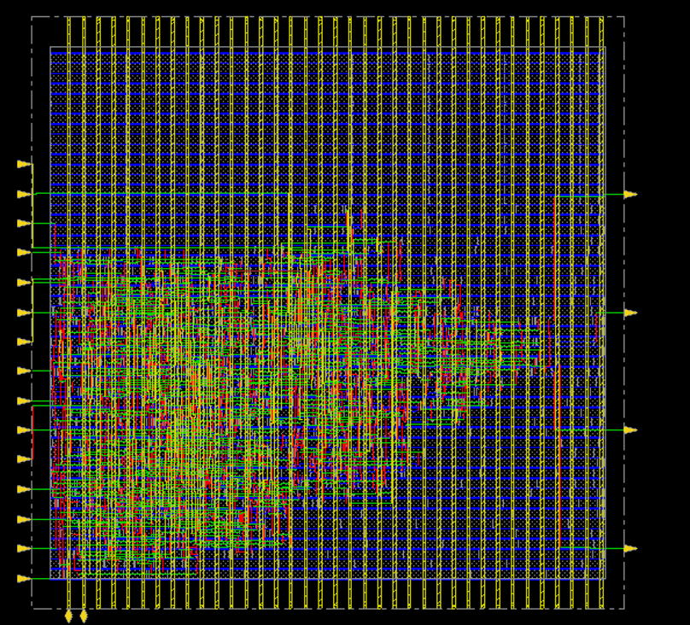
Physical Design – Adding optimum design

Slide 26
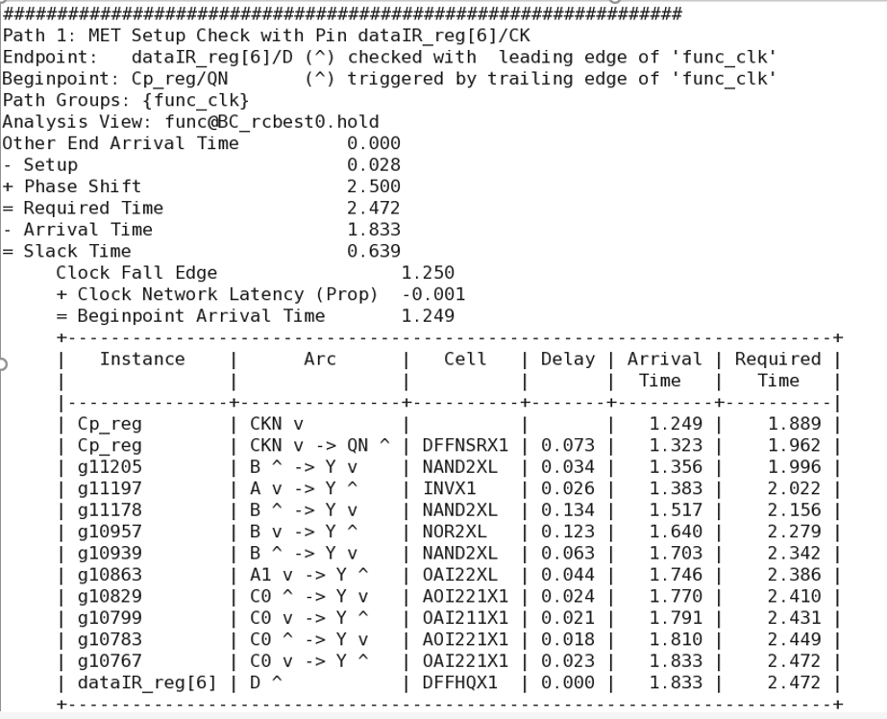
Physical Design – Report Timing
Slack time is positive and less than the required time

Slide 27
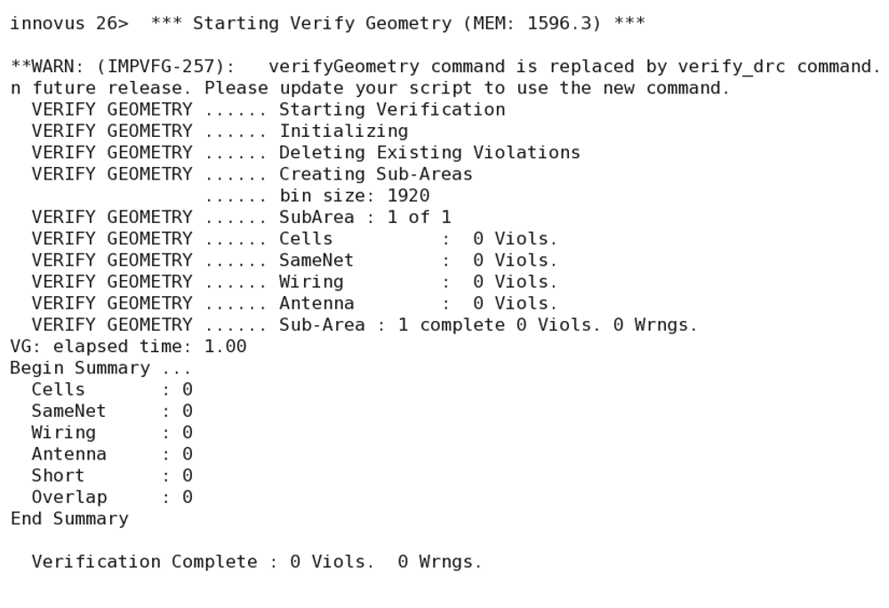
Physical Design – Geometry Verification

Slide 28
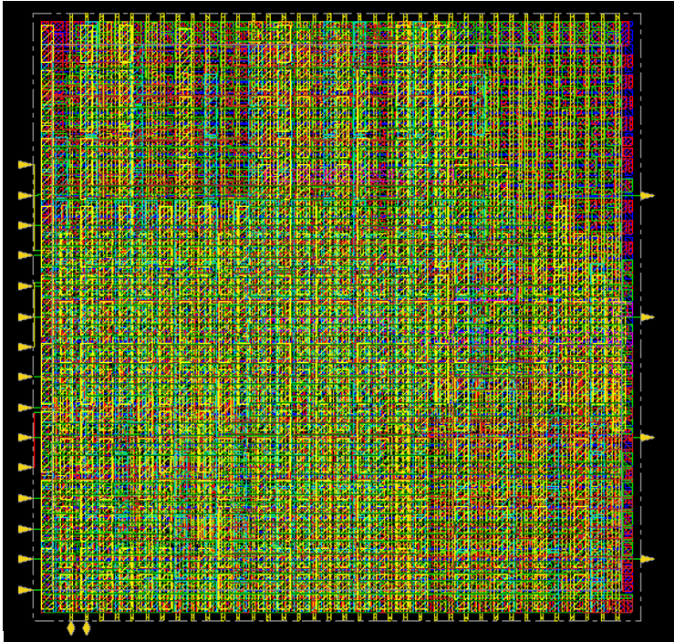
Physical Design – After Metal Fill
All the filler cell libraries are selected to avoid DRC errors later

Slide 29
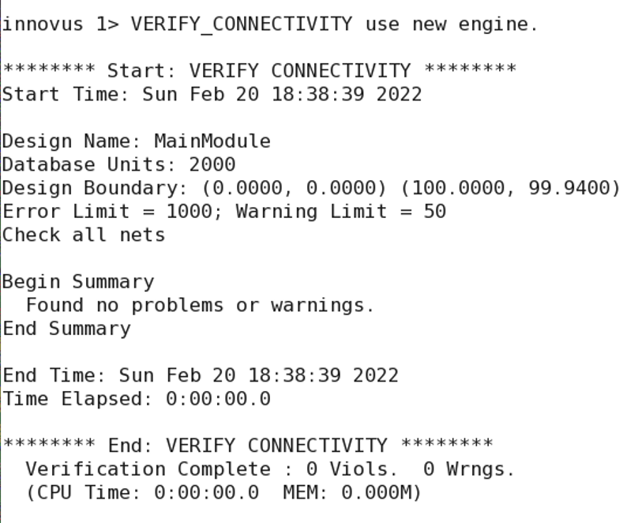
Physical Design – Connectivity Verification

Slide 30
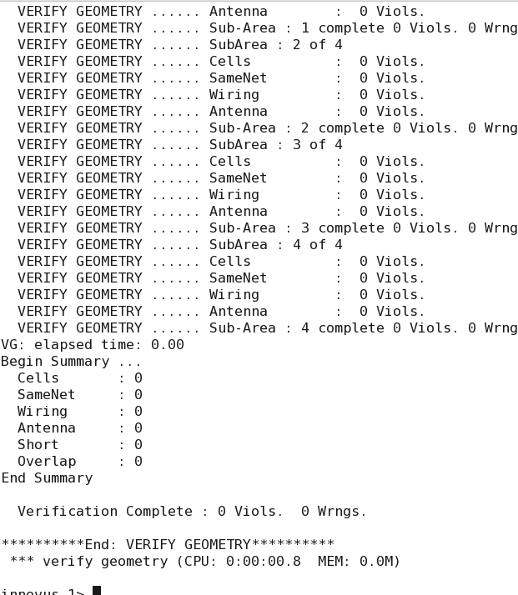
Physical Design – Geometry Verification

Slide 31

Physical Design – Layout at Virtuoso

Slide 32
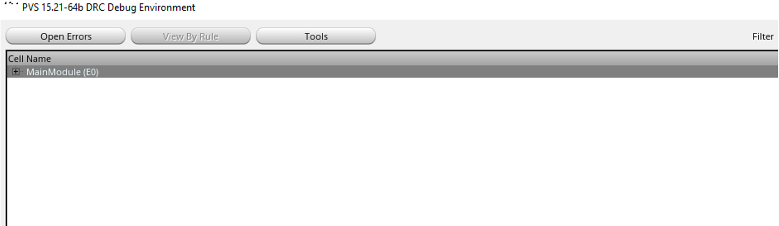
Physical Design – DRC Error

Slide 33
Terminologies of DRC errors
NIMP.SP.1 → Minimum N+ Implant Space >= 0.12 um
PIMP.SP.1 → Minimum P+ Implant Space >= 0.12 um
NW.SP.1 → Minimum N-well spacing to N-well (same potential) >= 0.3um
NW.W.1 → Minimum N-well width >= 0.3um
Offgrid check → Drawn layer is not aligned with the grid settings

Slide 34
Terminologies of DRC errors(Cont’d)
VIA1.E.3 → At least 2 Via1 must be used to join Metal1 and Metal2 when they are within 3.0 um of a metal plate(Metal1/Metal2) when the metal plate size has width>1.5 and length> 1.5
VIA2.E.3 → At least 2 Via2 must be used to join Metal2 and Metal3 when they are within 3.0 um of a metal plate(Metal2/Metal3) when the metal plate size has width>1.5 and length> 1.5
VIA3.E.3 → At least 2 Via3 must be used to join Metal23and Metal4 when they are within 3.0 um of a metal plate(Metal3/Metal4) when the metal plate size has width>1.5 and length> 1.5

Slide 35
Trial and Error
Case No | Physical Design Parameter | DRC Errors | Comment
1 | Die Size : 100*100 Input pin spacing : 2 Output pin spacing : 5 Other design parameters are followed from lab-sheet | NIMP.SP.1 → 34 NW.SP.1 → 29 NW.W.1 → 5 PIMP.SP.1 → 31 offgrid_check → 98 | Total Error = 196 Offgrid check error due to Geometry Violation error
2 | Same Die Size, Input pin spacing & Output pin spacing Core to IO boundary: Core to Left/Right : 3 Core to Top/Bottom : 4.94 Power Stripe Width : 0.5 Power Stripe Spacing : 2 First Power Stripe (X from Left) : 3 | NIMP.SP.1 → 39 NW.SP.1 → 26 NW.W.1 → 2 PIMP.SP.1 → 35 VIA1.E.3 → 1 VIA2.E.3 → 2 VIA3.E.3 → 1 | Total Error = 106 offgrid_check errors are gone but VIA errors are introduced

Slide 36
Trial and Error(Cont’d)
Case No | Physical Design Parameter | DRC Errors | Comment
3 | Die Size : 100*100 Input pin spacing : 5 Output pin spacing : 20 Other design parameters are followed from case 2 | NIMP.SP.1 → 25 NW.SP.1 → 25 NW.W.1 → 6 PIMP.SP.1 → 29 | Total Error = 85 VIA errors are gone
4 | Die Size : 200*150 Other design parameters are followed from case 2 | NIMP.SP.1 → 19 NW.SP.1 → 11 NW.W.1 → 9 PIMP.SP.1 → 14 | Total Error = 43 Spacing error decreases but well error increases
5 | Die Size : 200*150 Other design parameters are followed from case 4 & adding all the filler cell | 0 | Total Error = 0 All errors are gone
6 | Die Size : 100*100 Other design parameters are followed from case 3 & adding all the filler cell | 0 | Total Error = 0 All errors are gone

Slide 37


Slide 38
Appendix
EDA Playground Link : https://www.edaplayground.com/x/W42N
The nomenclature of DRC is errors is taken from gpdk045_drc library provided by Cadence Design Systems. Link to pdf: https://perso.telecom-paristech.fr/mathieu/ICS904_TP_LAYOUT/html/_static/doc/gpdk045_drc.pdf

